Slide 1
Ship it: reproducible work, a
small app and responsible use
How do we turn a notebook into something a colleague can repeat, use and trust?
AI and Data Science Professional | Session 23 of 24 | Module F: Ship it and present
KLAi Professional Learning | Jotham Martin Wambi
Notes:
Welcome back. For twenty-two sessions your work has lived in a notebook that only you could run. Today it leaves the notebook. You will make it repeatable, save the model, put the code on GitHub, and see how a small app is built. Then comes the part that decides whether anyone should use it: a model card, a watch for drift, a fairness audit by group and the duties under Uganda law.

Slide 2



Today in one view: what you will leave with
By the end of today you can
Make a notebook reproducible, save a model to a file and publish code and a small app for free
Write a model card and watch for data drift and concept drift
Run a fairness audit by group, spot a proxy variable, and name the main duties in the Uganda Data Protection and Privacy Act, 2019
Notes:
Here is what you can do by the end of today. You can make a notebook reproducible, which means a colleague gets your result, and you can save a trained model to a file and publish code and a small app for free. You can write a model card, and you can watch for data drift and concept drift.
And you can run a fairness audit by group, spot a proxy variable, and name the main duties in the Uganda Data Protection and Privacy Act of 2019. The lab uses the Nile Microfinance loans, and it ends with a folder you can keep and show.

Slide 3

Your two hours: concepts
first, then a notebook lab
Ideas with pictures first. Then you open the notebook. Then the checks and what you keep.
Notes:
We have two hours. The first ten minutes bring back Session 22 and set the question for today. Then forty-five minutes of concepts with no laptops open: how to make work repeatable, how to save and share it, and how to check it is fair and lawful. After a ten minute break we open one Colab notebook for a forty-five minute lab on the Nile Microfinance loans.
The last ten minutes are an exit check and what you keep. Please protect the lab time, because the fairness checks only make sense when you run them.

Slide 4

Three questions from last time
1. A language model states a fact that is in none of your documents. What is that called, and what did we add to reduce it?
2. Why do we keep an evaluation set of test questions for a document assistant?
3. What is a chunk?
Answer aloud first. Then we check together.
Notes:
Three quick questions from Session 22. Answer aloud first, and then we check together. It is a warm-up to bring last time back.
Question one. A language model states a fact that is in none of your documents. What is that called, and what did we add to reduce it?
A good answer is this. A hallucination: fluent text that is invented. Retrieval-augmented generation (RAG) finds passages in your own documents first and answers from them.
Question two. Why do we keep an evaluation set of test questions for a document assistant?
A good answer is this. So we can run the same questions after every change and see whether the answers got better or worse.
Question three. What is a chunk?
A good answer is this. A piece of a document, such as one paragraph of a policy, that is stored and searched on its own.
If you missed one, check your notes from last session tonight. Now to today.

Slide 5



Answers to the three questions from Session 22
Question | Short answer
A language model states a fact that is in none of your documents. What is that called, and what did we add to reduce it? | A hallucination: fluent text that is invented. Retrieval-augmented generation (RAG) finds passages in your own documents first and answers from them.
Why do we keep an evaluation set of test questions for a document assistant? | So we can run the same questions after every change and see whether the answers got better or worse.
What is a chunk? | A piece of a document, such as one paragraph of a policy, that is stored and searched on its own.
Notes:
Here are the answers to the three warm-up questions. A fact that appears in none of your documents is a hallucination: fluent text that is invented. Retrieval-augmented generation, or RAG, reduces it by finding passages in your own documents first. An evaluation set is a list of test questions with checked answers, so you can run it again after every change.
And a chunk is a piece of a document that is stored and searched on its own. Today is about the same habit of repeating and checking, applied to everything you ship. Which of the three was hardest?

Slide 6





Words we use today
Word | What it means
Reproducibility | A colleague who runs your notebook gets your result. It needs a fixed random seed, recorded library versions and a run from the top.
Model serialisation (persistence) | Saving a trained model to a file, for example with joblib or pickle, so it can be loaded later without training again.
Data drift (and concept drift) | Data drift: the inputs change after training. Concept drift: the link between the inputs and the outcome changes.
Fairness audit (proxy variable, disparate impact) | Compare approval and error rates across groups. A proxy variable stands in for a column you left out. Disparate impact is the ratio of two approval rates.
Personal data (data subject, data controller) | Information that identifies a person. The person is the data subject. The organisation that decides how it is used is the data controller.
Notes:
Five words for today. I give the plain meaning of each, and we use every one of them before the end of the session.
Reproducibility. A colleague who runs your notebook gets your result. It needs a fixed random seed, recorded library versions and a run from the top.
Model serialisation (persistence). Saving a trained model to a file, for example with joblib or pickle, so it can be loaded later without training again.
Data drift (and concept drift). Data drift: the inputs change after training. Concept drift: the link between the inputs and the outcome changes.
Fairness audit (proxy variable, disparate impact). Compare approval and error rates across groups. A proxy variable stands in for a column you left out. Disparate impact is the ratio of two approval rates.
Personal data (data subject, data controller). Information that identifies a person. The person is the data subject. The organisation that decides how it is used is the data controller.

Slide 7
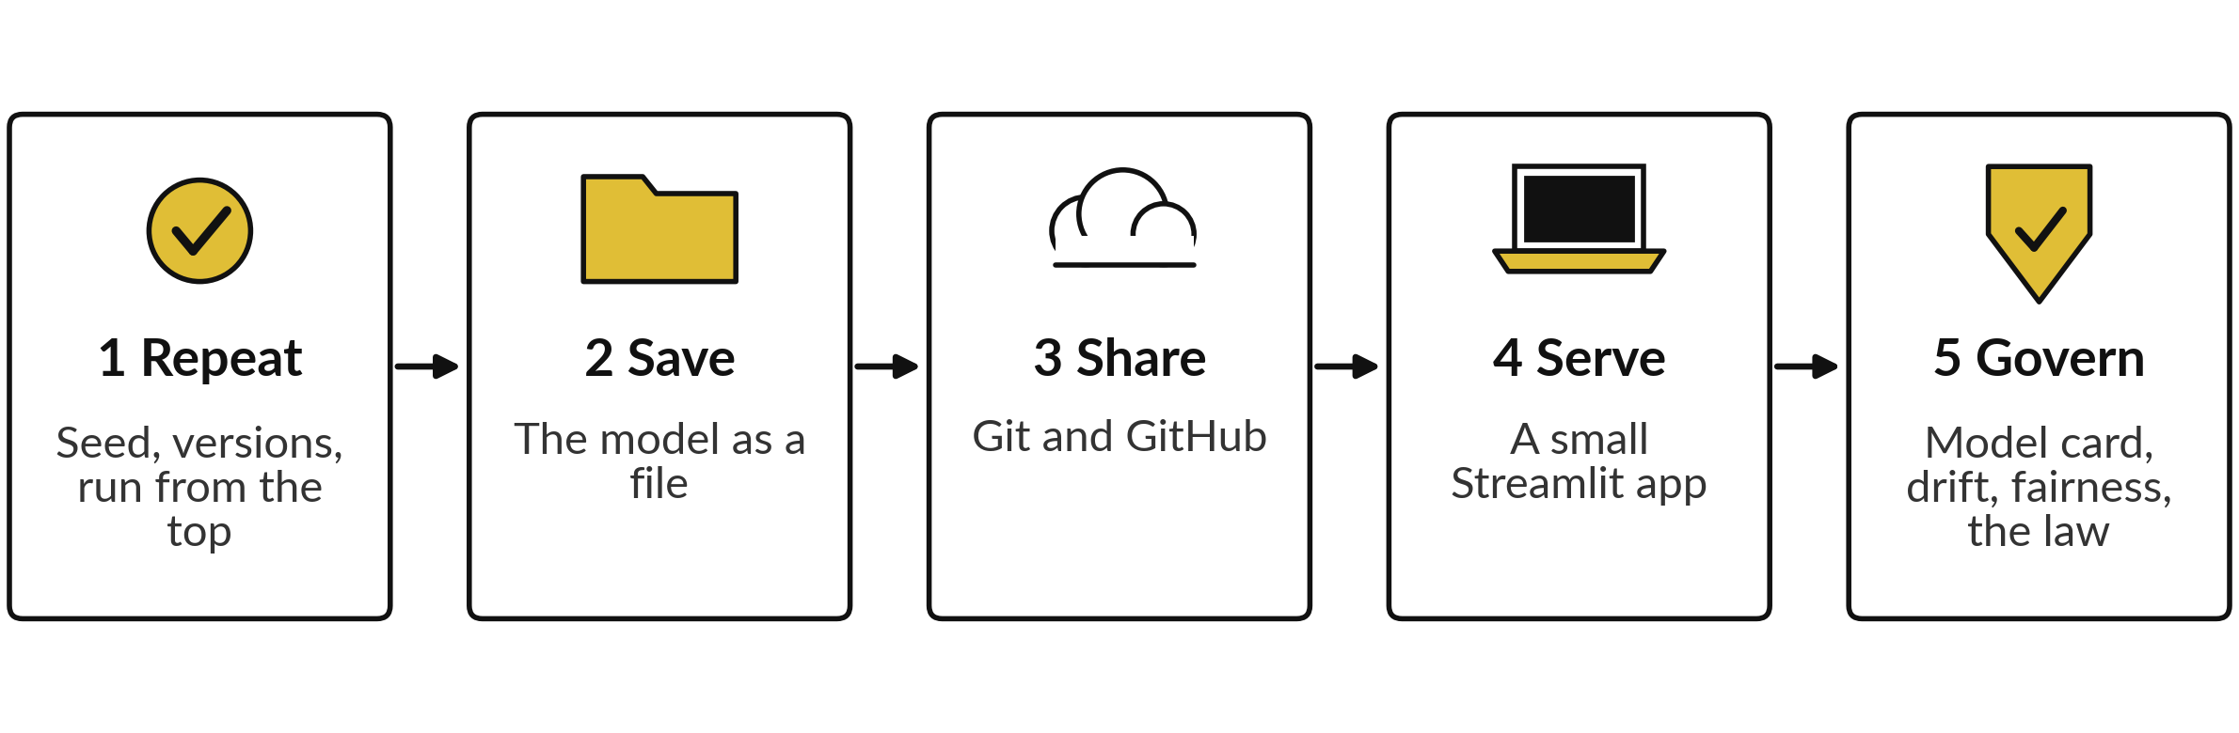
Shipping a model means five
jobs after the notebook works
Today covers all five. The lab does 1 and 2, writes the files for 4, and does 5. You do 3 and the deployment with your own free accounts.
Notes:
A notebook that works for you is only the start. Five jobs follow. First, make it repeatable with a seed, recorded library versions and a clean run from the top. Second, save the trained model as a file. Third, share the code with Git and GitHub. Fourth, serve the model through a small web app built with Streamlit.
And fifth, govern it: write a model card, watch for drift, audit it for fairness by group and check your duties under the law. The first four are craft. The fifth decides whether anyone should trust the other four. Which job do you skip most often today?

Slide 8
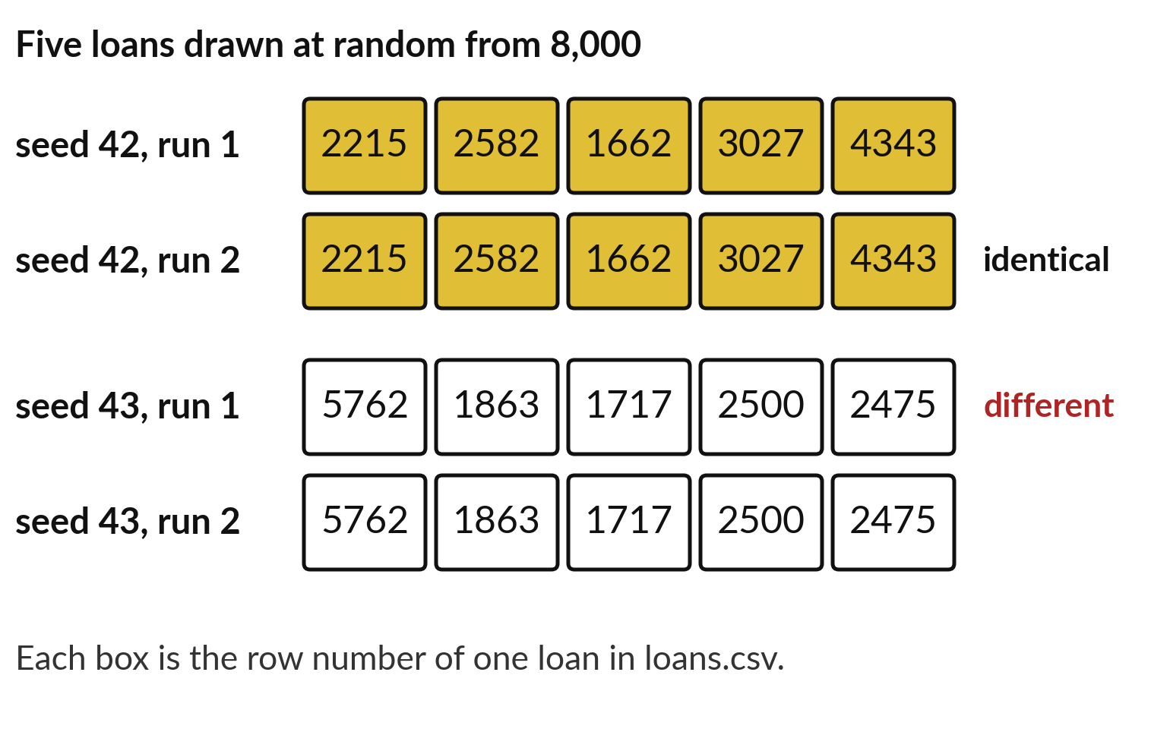
A random seed makes a random draw repeatable
Seed (random_state): a starting number for the random generator. The same seed gives the same draw.
In pandas: random_state=42.
In Sheets, paste RAND as values.
Use one seed for every random split.
Notes:
Many steps in data science use chance: drawing a sample, splitting training and test sets, starting a model. If chance changes every run, nobody can repeat your result. A random seed fixes it. It is a starting number for the random generator. Look at the picture. Drawing five loans with seed forty-two gives the same five row numbers twice.
Seed forty-three gives a different draw, but again the same twice. In a spreadsheet the same problem exists with RAND, which changes every time the sheet recalculates, and you freeze it by pasting the values. Which random steps have you used so far in this course?

Slide 9
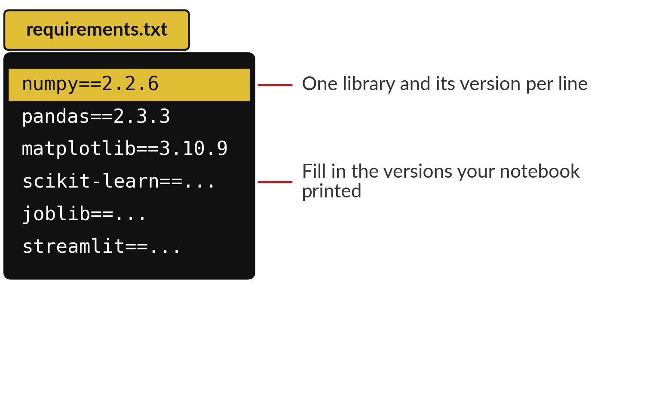
A requirements file records which
library versions your notebook used
Requirements file (requirements.txt): a text file that lists each library and its version.
The versions shown come from one machine. Print your own: numpy.__version__, or pip freeze.
Keep only libraries you import.
Install with pip install -r requirements.txt.
Notes:
Libraries change over time, and a notebook that works with one version can fail or give different numbers with another. So you record the versions. In Python every library prints its version, for example numpy is 2.2.6 and pandas is 2.3.3 on the machine that built this slide.
Your own versions will differ, and that is fine. You list the libraries you import in a plain text file called requirements dot txt, one per line, with the version after two equals signs. A colleague, or a deployment service, installs exactly those. Which libraries would your course project notebook need?

Slide 10
Restart and run all is the test of a notebook
Works only for you
Works for anyone
You ran cells in a different order.
Your open session remembers a deleted cell.
A colleague meets a NameError.
Runtime, then Restart session and run all.
Fix the first error and run again.
Share when it runs top to bottom.
Run it from the top before you share it.
Notes:
The third habit is the order. While you work you run cells in any order, and your open session remembers every name you ever created, even from a cell you deleted. Your colleague opens the notebook with an empty session and runs it from the top. If a cell depends on something that is no longer there, they meet an error that says a name is not defined.
The test is simple. In Colab choose Runtime, then Restart session and run all. Fix the first error, then run again. Only share a notebook that runs from top to bottom by itself. Has this ever happened to you?

Slide 11
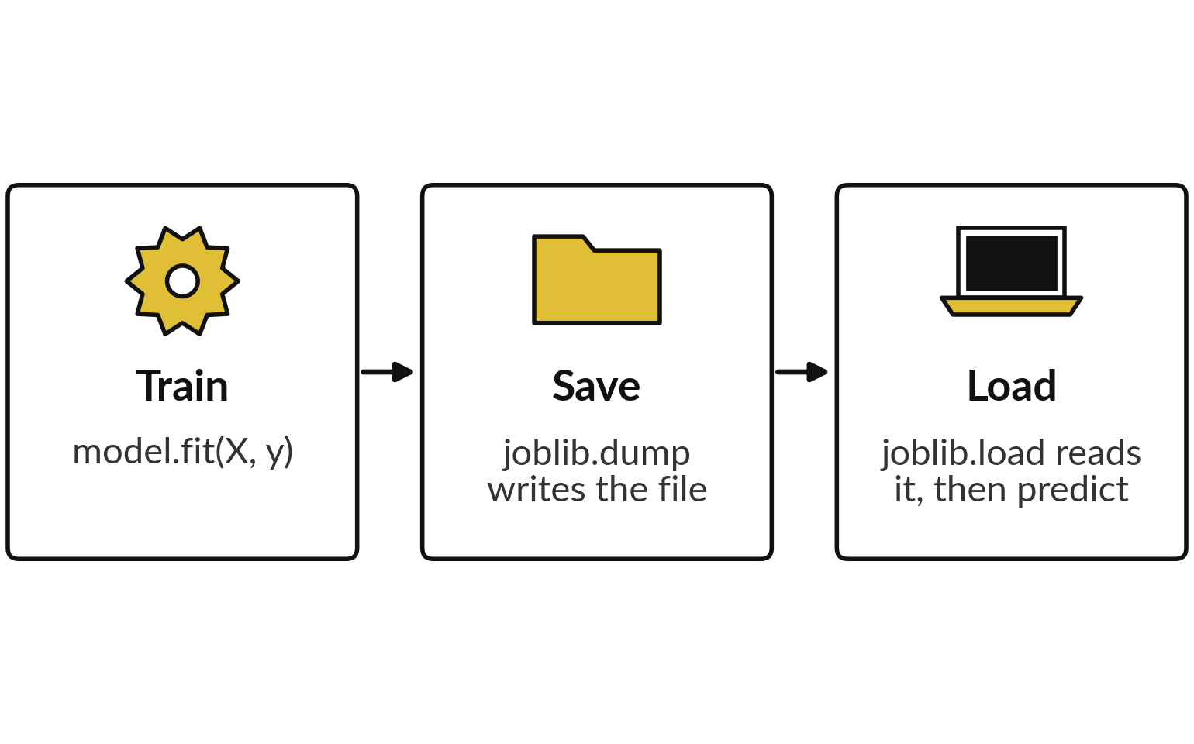
Model serialisation saves a trained
model to a file you can load later
Model serialisation (persistence): saving a trained model to a file.
Tools: joblib or pickle. joblib uses pickle underneath.
Load only files you trust: loading can run hidden code.
Use the same library versions.
Notes:
Training a model takes effort, so you save the result. Model serialisation, also called persistence, writes the trained model to a file. In Python the common tool for scikit-learn models is joblib, and the standard Python tool is pickle. Joblib uses pickle underneath, so it carries the same risk.
The picture shows three steps: train, save with dump, and load with load, then predict. Two warnings. My understanding from the library documentation is that loading a file can run code that is inside it, so never load a model file from a stranger. And save and load with the same library versions, or you may get warnings or wrong results.
Where would you store a model file at work?

Slide 12
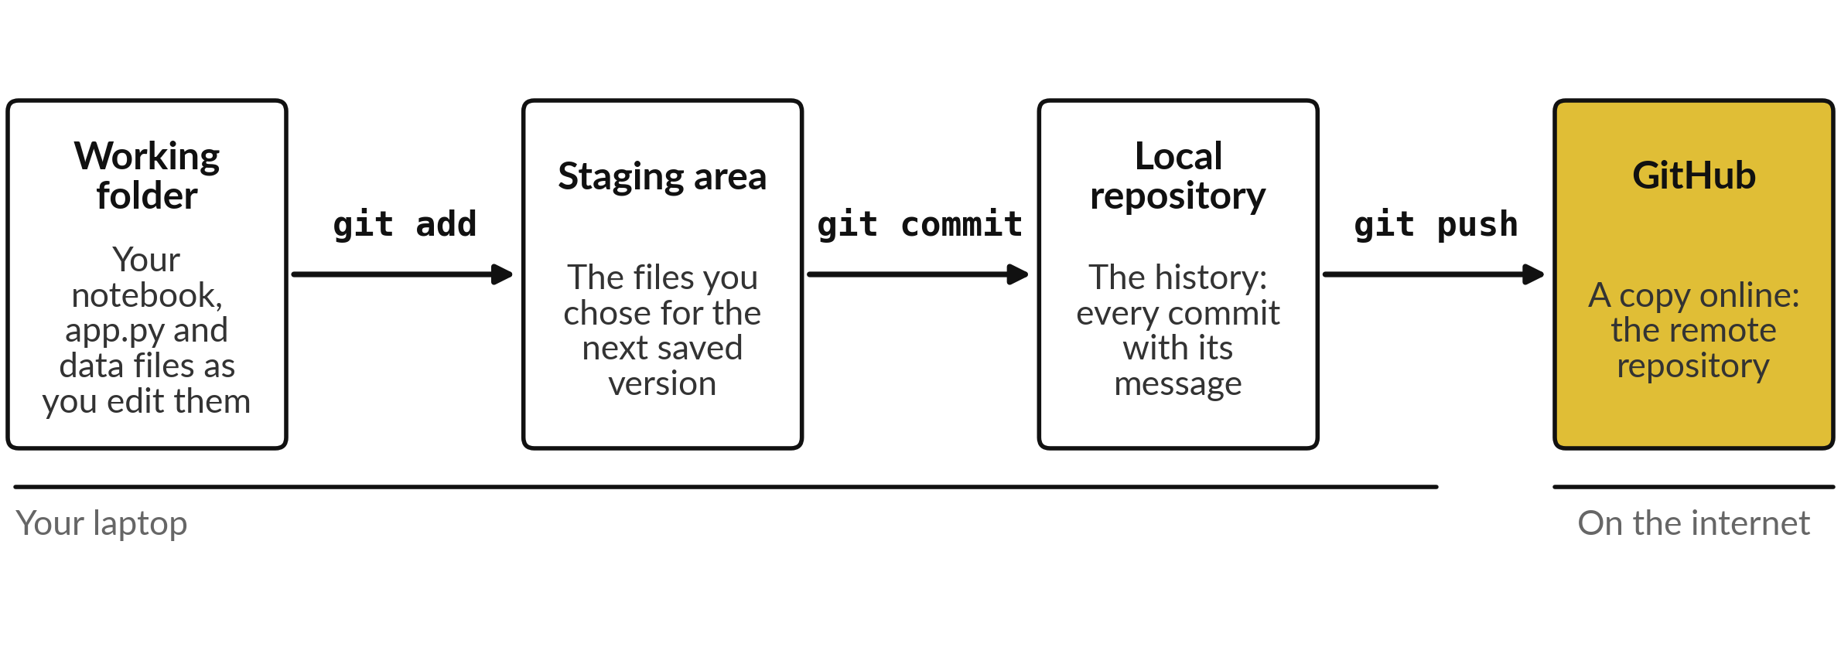
Git keeps a history of your project,
and GitHub keeps a copy online
Git is the tool on your laptop. GitHub hosts a copy online.
Notes:
Git is a tool that keeps the history of a project folder. The folder you edit is the working folder. With git add you choose which changed files go into the next saved version. With git commit you save that version in your local repository, together with a short message saying what changed.
And with git push you upload your commits to GitHub, a website that hosts a copy so colleagues can see it. In Google Drive you have version history. Git is the same idea, but you choose when to save a version and you name it. What would your commit messages say?

Slide 13




Six words you will hear about Git and GitHub
Word | Plain meaning | You will see
Repository (repo) | The project folder together with its full history. | github.com/you/loan-model
Commit | One saved version, with a message saying what changed. | git commit -m "first version"
Branch | A separate line of work. The main line is called main. | main
Push | Upload your commits to GitHub. | git push -u origin main
README | The front page of a repository: what the project is and how to run it. | README.md
.gitignore | A list of files Git must never track, such as data with personal details or passwords. | .gitignore
Notes:
Six words you will meet the first day you use GitHub. A repository, or repo, is the project folder together with its history. A commit is one saved version with a message. A branch is a separate line of work, and the main line is called main. Push means uploading your commits to GitHub.
A README is the front page of the repository: what the project is and how to run it. And a dot gitignore file lists files Git must never track, such as data with personal details or passwords. Which of these would you create first?

Slide 14
A public repository is public: personal
data, passwords and keys never go in
Put in
Never put in
The notebook, run from the top.
app.py and requirements.txt.
A README and the model card.
Generated or public data.
Names, phones or loan records of real people.
Passwords, keys and tokens.
Data your employer has not cleared.
Deleting a file later does not erase its history. Check before you push.
Notes:
Anyone on the internet can read a public repository and copy it. So decide what goes in before the first push. The notebook, the app file, the requirements file, a README and the model card all belong. Data should be generated or public. Never put in personal data such as names, phone numbers or the loan records of real people, and never passwords, keys or tokens, and never data your employer has not agreed to share.
Remember that Git keeps history, so deleting a file in a later commit does not remove it from the earlier ones. A private repository exists, but check the current terms. What would you check in your own folder?

Slide 15
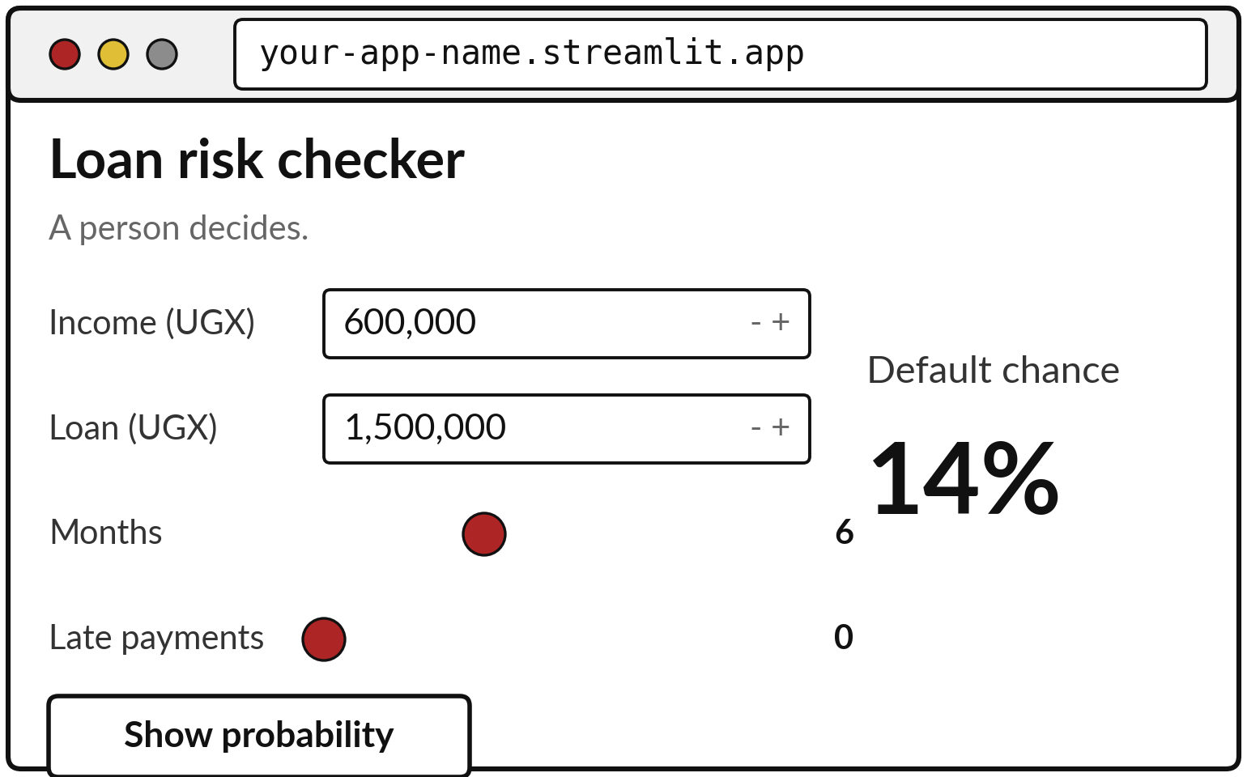
A Streamlit app turns a
saved model into a web page
Streamlit: a free Python library that builds a web page from a script.
You write inputs and output. Streamlit draws the page.
These inputs give 14% chance of default.
A person makes the decision.
Notes:
Here is what a small app looks like. A person types an income and a loan amount, moves two sliders, and presses a button. The page shows the predicted chance of default, which is 14 percent for these inputs, computed from the same model you will save in the lab.
Streamlit is a free Python library that builds this page from a script. You describe the inputs and the output, and it does the web work. Notice the caption: this is a teaching model on fictional data, and a person decides. Who at your workplace would use an app like this?

Slide 16
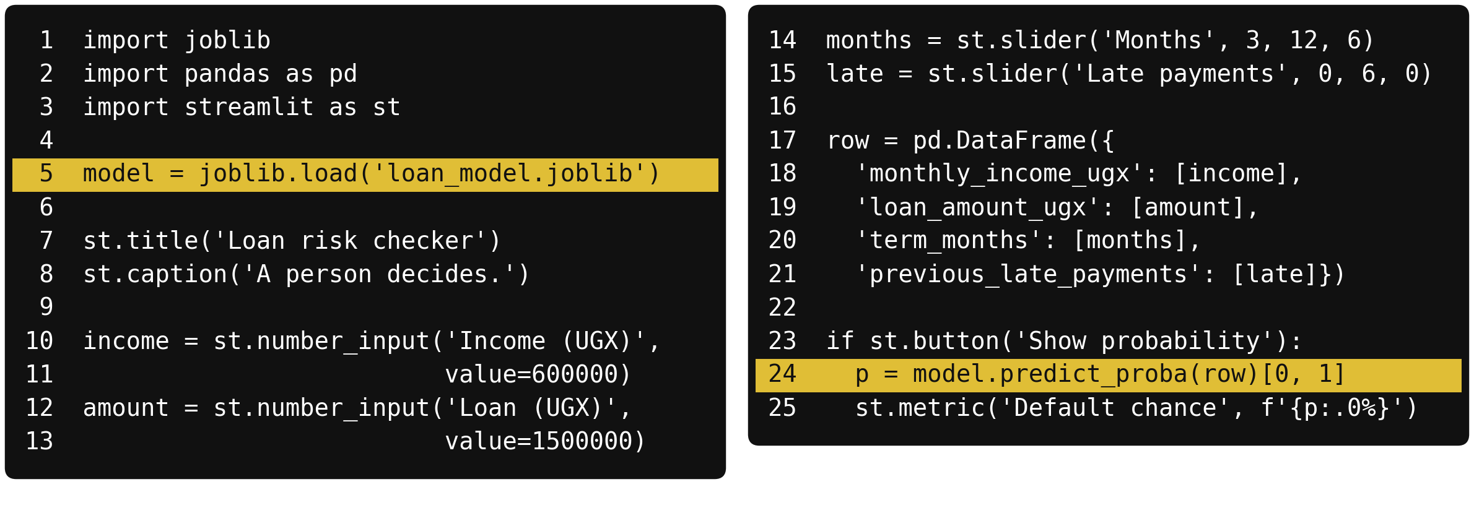
The whole app is about 25 lines: load
the model, ask for four inputs, predict
Gold lines: load the model (line 5) and predict (line 24).
Notes:
This is the whole app. Lines one to three import the libraries. Line five loads the saved model. Lines seven and eight give the page a title and a caption. Lines ten to fifteen create four inputs: two number boxes and two sliders. Lines seventeen to twenty-one put the four values into a one-row table with the same column names the model was trained on.
Then lines twenty-three to twenty-five add a button which, when pressed, calls predict probability and shows the result. Streamlit runs the script again from the top whenever someone changes an input. Which line would you change first to show a different title?

Slide 17
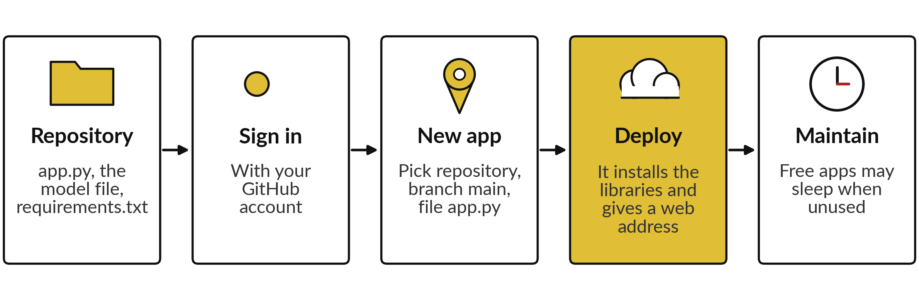
Streamlit Community Cloud can deploy
your app from a GitHub repository
Deploy: put the app on a server. Free at the time of writing, with limits on resources and sleeping apps. Check current terms, including private repositories.
Notes:
To deploy means to put the app on a server so that other people can open it with a web address. Streamlit Community Cloud can do this for free from a GitHub repository. You need a repository with app dot py, the model file and requirements dot txt.
You sign in with your GitHub account, create a new app, choose the repository, the branch main and the file, and press deploy. It installs the libraries and gives you an address. At the time of writing it is free for public repositories and apps may go to sleep when nobody uses them, with reports of about twelve hours.
Limits change, so check the current terms. It suits learning and demonstrations. A business-critical service needs something stronger. What would you use it for?

Slide 18



A model card is a one-page note on
what a model is for and where it can fail
Section | The loan model (an illustrative card)
Purpose | Ranks loan applications so an officer knows which to review first. It does not approve or refuse.
Data | 8,000 fictional loans, 2023-01 to 2025-09. collection_calls was removed because it leaks the answer.
Metrics | Simplified four-variable model. AUC 0.727 on 2,000 held-out loans. At decision threshold 0.15 it flags 28% of loans and finds 59% of defaults.
Limits | Fictional data. 379 loans lack income and are filled with the median. Four variables only. Not tested after the data changes.
Fairness and review | On the held-out loans, approval women 72.3%, men 71.6%. Reviewed by the credit manager and the data protection officer.
Update the card every time the model changes.
Notes:
A model card is a short note, usually one page, that travels with a model. It says what the model is for, what data it learned from, how well it works, where it can fail, and who reviews it. This card is for the loan model you will build.
The purpose is to rank applications for an officer. It makes no decision. The data is 8,000 fictional loans, with the leaking column removed. This is a simplified model with four variables, fitted on the six thousand training loans. On the 2,000 held-out loans it has never seen, the area under the curve is 0.727, and at a decision threshold of 0.15 it flags 28 percent of loans and finds 59 percent of defaults.
The limits and the fairness check complete it. Which section would your manager read first?

Slide 19
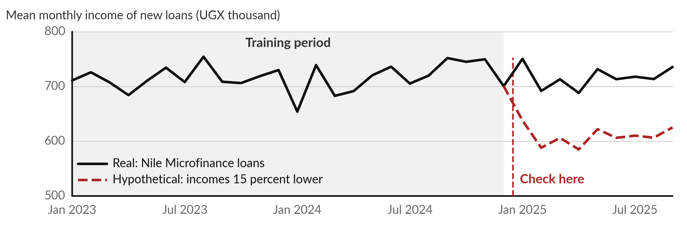
Data drift: when new data stops looking
like the training data, the model gets worse
Solid: real. Dashed: a hypothetical 15 percent fall from month 25.
Notes:
Data drift means the inputs change after the model was trained. The solid line is real: the mean monthly income of new loans in each month. For the first twenty-four months, the training period, it averages 716 thousand shillings, and in the next nine months 717. So our real data shows no drift.
The dashed line is hypothetical: the same months, but with incomes fifteen percent lower, which would average 610. A model trained on the old picture would now see borrowers it has never met. You catch it by comparing each month of new inputs with the training period. What other input could drift in your data?

Slide 20
Data drift and concept drift are different problems
Data drift
Concept drift
The inputs change: incomes or loan sizes move.
Check: compare each month of inputs with the training period.
The link between inputs and outcome changes. Illustration: a new repayment option changes the risk.
Check: compare predicted with actual defaults.
Plan monitoring, set a review date, retrain when needed.
Notes:
There are two kinds of drift. In data drift the inputs change, so new borrowers look different from the ones the model learned from. You catch it by comparing summaries of each month of inputs with the training period. In concept drift the relationship between inputs and outcome changes.
As an illustration, suppose a new repayment option changes how borrowers with a given income behave. The inputs look the same but the risk has moved. You catch that only when real outcomes arrive, by comparing predicted with actual defaults. In both cases the answer is a monitoring plan, a review date and retraining on newer data.
When would your outcomes arrive?

Slide 21
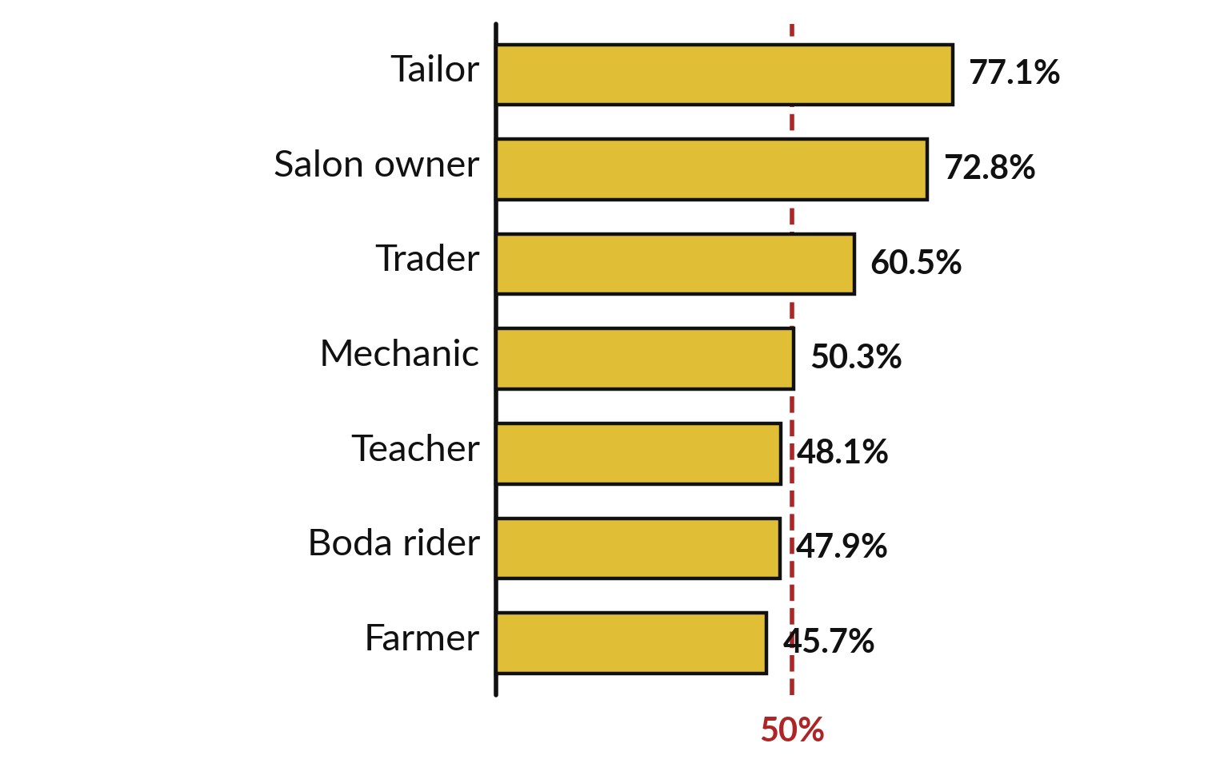
A proxy variable carries the
information of a column you removed
Proxy variable: a variable that stands in for another. Occupation stands in for gender.
Women are 77% of tailors and 73% of salon owners.
Dropping the gender column keeps the information.
Occupation rules can treat men and women differently.
Notes:
Suppose you remove the gender column so the model cannot use it. Fairness is not solved, because other columns can stand in for it. A variable that stands in for another is a proxy variable. The bars show the share of women among 7,621 loans with a known income, by occupation.
Women are 77 percent of tailors and 73 percent of salon owners, and under half of farmers. So a rule that treats occupations differently will treat men and women differently, even though it never sees gender. Which column in your own data might be a proxy?

Slide 22
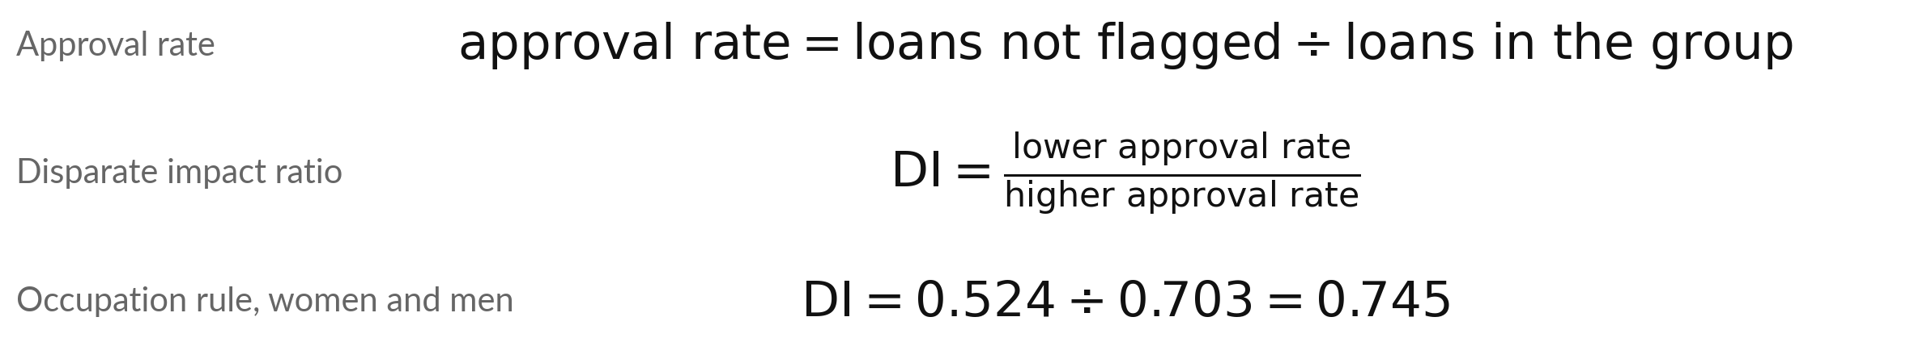
Disparate impact: divide the lower
approval rate by the higher one
Symbol | What it means | In our data
Approval rate | Share of a group not flagged as high risk. | women 70.3%, men 52.4%
DI | Disparate impact ratio. 1.00 means equal rates. | 0.745 for the occupation rule
0.8 rule of thumb | Below 0.8 is a warning. It comes from US employment practice and is no Ugandan legal test. | 0.745 is below 0.8
A screening number: it starts a question.
Notes:
Here is how to measure unequal treatment. The approval rate of a group is the share of its loans that are not flagged as high risk. Disparate impact compares two groups: divide the lower approval rate by the higher one. A ratio of one means equal rates. For the occupation rule, men are approved 52.4 percent of the time and women 70.3 percent, so the ratio is 0.745.
A common rule of thumb, used in United States employment practice, treats a ratio below zero point eight as a warning. It is not a Ugandan legal test and it is only a prompt to investigate. What would you ask next?

Slide 23
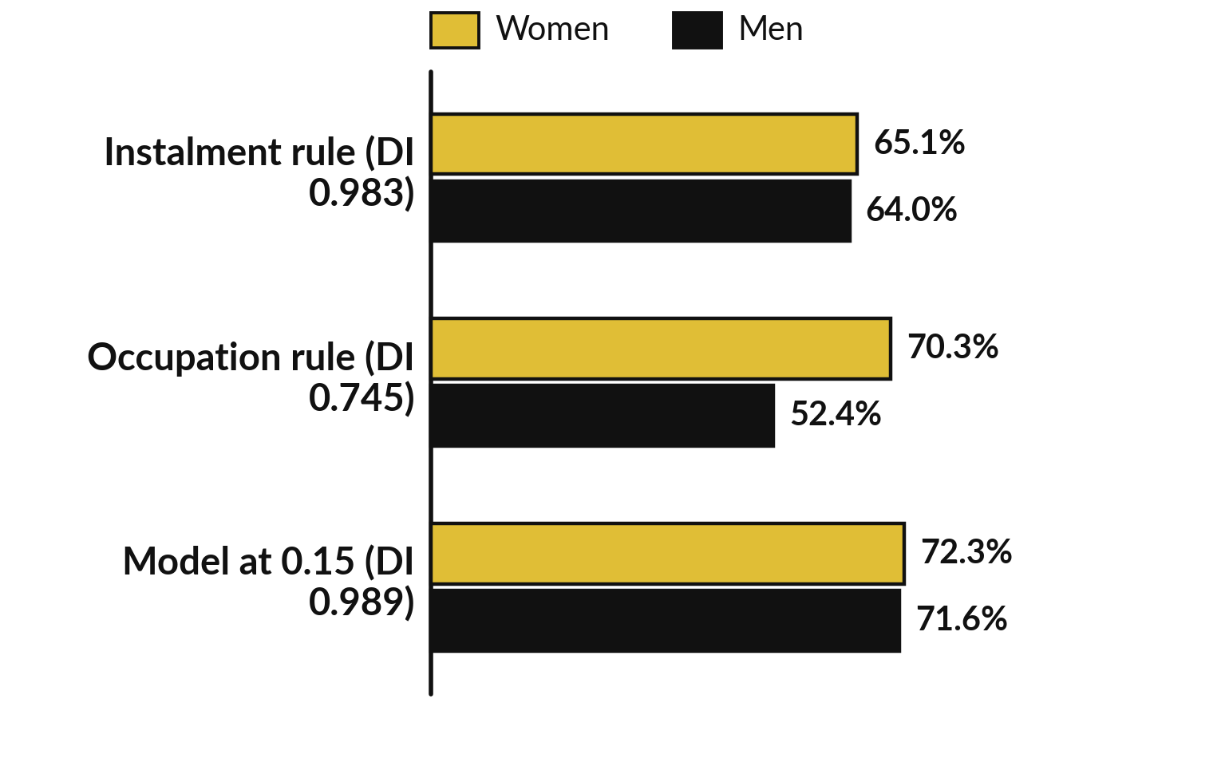
A fairness audit compares approval
rates by group, and one rule raises a flag
Fairness audit: compare approval and error rates across groups.
Approval rate: share of loans not flagged.
The occupation rule favours women.
The other two treat groups alike.
Notes:
Now the fairness audit. We take three ways to flag a loan as high risk and compute the approval rate for women and men. These are the 2,000 held-out loans that have an income. Rule one flags an instalment-to-income ratio above zero point four, which is about thirty-five percent of income before the illustrative fifteen percent charge: women 65.1 percent, men 64.0.
Rule two flags occupations whose default rate on the training loans is above twelve percent: women 70.3, men 52.4, a ratio of 0.745. The model at a threshold of 0.15 gives 72.3 and 71.6. None of them uses gender, yet one raises a flag. That is the point of auditing the output rather than trusting the inputs.
Which group would you check first at work?

Slide 24


Error rates differ too: the occupation
rule misses more defaults among women
Rule and group | Approval rate | Defaults missed (false negative rate) | Repaid loans flagged (false positive rate)
Instalment rule, women | 65.1% | 32.8% | 30.5%
Instalment rule, men | 64.0% | 37.5% | 32.0%
Occupation rule, women | 70.3% | 65.7% | 29.1%
Occupation rule, men | 52.4% | 42.3% | 46.1%
False negative rate: share of actual defaults the rule did not flag. False positive rate: share of repaid loans it flagged.
Notes:
Approval rates are one side. Error rates are the other. A false negative is a default the rule did not flag. A false positive is a repaid loan the rule flagged. The instalment rule makes errors of a similar size for women and men. The occupation rule does not.
It misses 65.7 percent of defaults among women and 42.3 percent among men, and it flags 46.1 percent of repaid loans among men against 29.1 percent among women. So women who will default are missed more often, and men who will repay are flagged more often. Both are harms, to the lender and to the borrower.
Which error costs more at your workplace?

Slide 25




Uganda's Data Protection and Privacy Act,
2019: the key roles (a teaching summary)
Term | Plain meaning | In a loan file
Personal data | Information from which a person can be identified. | Name, phone number, loan record
Data subject | The person the data is about. | The borrower
Data controller | The organisation that decides why and how personal data is used. | The lender
Data processor | Someone who handles data for the controller. | A cloud or software provider
Regulator | My understanding: the Personal Data Protection Office, under NITA-U. | Where complaints go
Hedged summary from public descriptions. Not legal advice. Read the Act, or ask your data protection officer or a lawyer.
Notes:
Now the law. This is a teaching summary in plain words from public descriptions of the Act, and it is not legal advice. Personal data is information from which a person can be identified, such as a name, a phone number or a loan record. The person it describes is the data subject, here the borrower.
The organisation that decides why and how the data is used is the data controller, here the lender. A data processor handles data on the controller behalf, for example a cloud provider. My understanding is that the regulator is the Personal Data Protection Office under NITA-U. For your own case, ask your data protection officer or a lawyer.
Who is the data controller where you work?

Slide 26







Public summaries of the Act describe seven
principles: collect less, say why, keep it safe
Principle | In plain words
Accountability | Someone is responsible and can show what was done.
Fair and lawful processing | Use data fairly and within the law.
Adequate and relevant data | Collect only what the purpose needs.
Kept only as long as needed | Delete data when the purpose ends.
Quality of information | Keep data accurate and up to date.
Openness and participation | Tell people what you hold and why.
Safety and security | Protect data from loss, leaks and misuse.
Teaching summary of public descriptions. Not legal advice. Read the Act for the exact wording.
Notes:
Public summaries of the Act describe seven principles. Accountability: someone is responsible and can show what was done. Fair and lawful processing. Collect only adequate and relevant data, which means only what the purpose needs. Keep data only as long as needed. Keep it accurate. Be open: tell people what you hold and why.
And protect it from loss, leaks and misuse. For a model team, that translates into jobs: write down the purpose on the model card, drop columns you do not need, and never publish personal data. This is a summary, so read the Act itself for the exact words.
Which principle does your current project test most?

Slide 27


Data subjects have rights, and a
model team has matching jobs
Right | In plain words | A model team keeps
Access | Ask what data an organisation holds about you. | A record of which data feeds the model
Correction | Ask for wrong data to be fixed. | A way to correct a record and retrain
Erasure | Ask for data to be deleted, in the cases the law allows. | A deletion process that covers copies
Automated decisions | Ask not to be subject to a decision taken only by a computer. | A person who reviews the model output
Consent and cloud tools | My understanding: the Act expects a lawful basis such as consent. Personal data sent outside Uganda may need safeguards. | No real personal data in Colab, GitHub or an app host until checked
My understanding from public summaries. Check the Act and take advice for your own case.
Notes:
Public summaries list rights for data subjects. Access: asking what data an organisation holds about you. Correction: asking for wrong data to be fixed. Erasure: asking for data to be deleted, in the cases the law allows. And a right related to automated decisions: asking not to be subject to a decision taken only by a computer.
For a model team each right becomes a job: record what data feeds the model, correct and retrain, delete copies, and keep a person who reviews the output. One more row: my understanding is that the Act expects a lawful basis such as consent, and that sending personal data to a server outside Uganda may need extra safeguards, so check before you put real personal data into Colab, GitHub or an app host.
Ask your data protection officer. Which of these would be hardest in your organisation?

Slide 28


Where you will use this at work: make
it repeatable, then make it checkable
Your job | What you ship | What today lets you do
Credit analyst at a bank or SACCO, using Python and scikit-learn | A default-risk model | Save it with joblib, write a model card, and audit approval and error rates by gender and district before release.
Officer in a ministry, using pandas and Excel | A monthly report notebook | Fix the seed, record the versions, and rerun it each month from the top so the numbers reproduce.
Sales analyst at a retailer, using Streamlit | A forecast tool for branch managers | Wrap the model in a small app, with a README, in a repository that holds no customer data.
Data officer at an NGO, using GitHub | A survey analysis | Keep the code in Git, keep personal data out, and check the duties of the data controller.
Notes:
Where will you use this on Monday?
Four examples. A credit analyst at a bank or a SACCO who builds a default model should save it with joblib, write a model card and audit approval and error rates by gender and district before release. An officer in a ministry whose monthly report must reproduce should fix the seed, record the versions and rerun it from the top each month.
A sales analyst can wrap a forecast in a small Streamlit app for branch managers, in a repository with no customer data. A data officer at an NGO can keep the analysis in Git, keep personal data out, and check the duties of a data controller. Which of these is closest to your job?

Slide 29
Read the recipe before the lab: a
seed and an approval rate by group
In plain words
known = test.dropna(subset=['monthly_income_ugx'])
pay = known.loan_amount_ugx * 1.15 / known.term_months
ratio = pay / known.monthly_income_ugx
known = known.assign(flag=(ratio > 0.40).astype(int))
approval = 1 - known.groupby('gender').flag.mean()
print(approval.round(3).to_dict())
print(round(approval.min() / approval.max(), 3))
Line 1 keeps the held-out (test) loans that have an income.
Lines 2 to 4 flag a loan when the ratio (instalment_to_income) is above 0.40. The 1.15 is an illustrative charge factor.
Line 5 is the approval rate: one minus the flag rate, for each gender.
Line 7 is the disparate impact ratio: 0.983.
{'F': 0.651, 'M': 0.64}
0.983
Notes:
Before the lab, read this recipe. The variable test holds the two thousand held-out loans. Line one keeps those that have a monthly income. Lines two to four work out the instalment-to-income ratio, using the illustrative one point one five charge factor, and flag the loan when it is above zero point four.
Line five groups by gender and takes one minus the mean flag, which is the approval rate. The output says women 65.1 percent and men 64.0. Line seven divides the lower rate by the higher one, giving 0.983, close to one. In the lab you do the same with the occupation rule and with the model.
What would you expect for the occupation rule?

Slide 30
Part 2: the notebook lab
Close the slides. Open the notebook.
Notes:
That is the end of the ideas. Open the Colab notebook called Session 23, Ship it. Run the first cell, which puts the data files next to the notebook, and then the check cell. In every step predict first, then run, then read the output, then change one thing and see what moves.
The checks tell you whether your answer matches. You do not need Streamlit installed, because the lab writes the app file and you deploy it later with your own account.

Slide 31
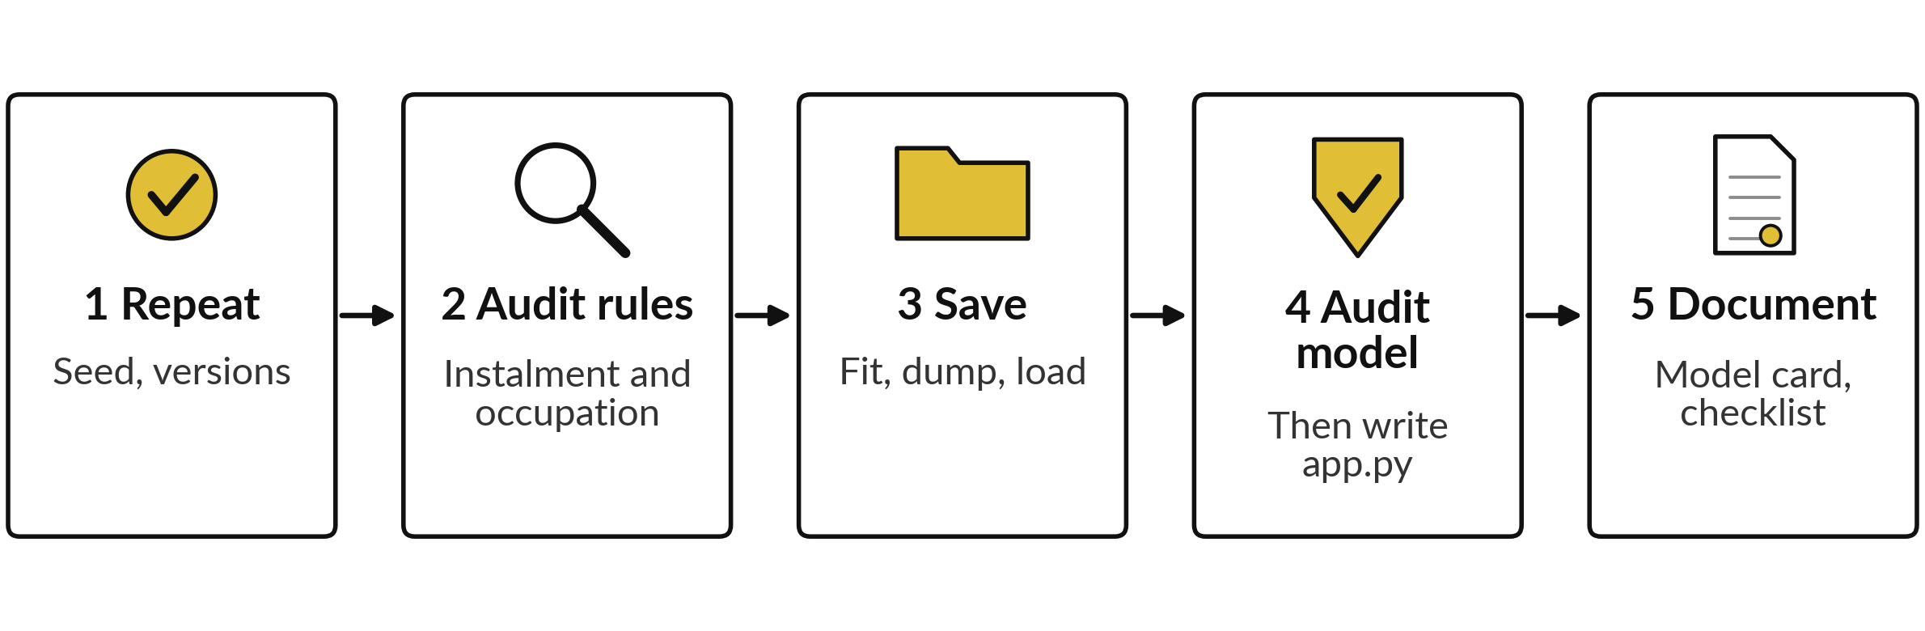
The lab has five parts, and you
keep a folder ready to push
Twenty-seven checks in 45 minutes. In each step: predict, run, read, change one thing.
Notes:
Here is the map of the lab. Step one, draw loans with a seed twice and check you get the same loans, and print your versions. Step two, split the loans once, then audit two rules on the held-out loans by gender: the instalment rule and the occupation rule, with approval rates, disparate impact and error rates.
Step three, fit a pipeline on the training loans only, save it with joblib, load it back and check it gives identical predictions. Step four, audit the model on the held-out loans the same way, then write the app file and the requirements file. Step five, complete a model card and a data protection checklist. Please do not skip the predictions. They are where you learn.

Slide 32







Check your numbers before you move on
What you compute | You should get
Row numbers drawn with random_state=42 | 2215, 2582, 1662, 3027, 4343
Default rate: women, and Masaka | 12.1% and 14.8%
Instalment rule (held-out loans): approval women, men, and DI | 65.1%, 64.0%, 0.983
Occupation rule (held-out loans): approval women, men, and DI | 70.3%, 52.4%, 0.745
Occupation rule: defaults missed, women and men | 65.7% and 42.3%
Model: held-out AUC, and first-loan probability | 0.727 and 0.22
Model at 0.15: approval women, men | 72.3% and 71.6%
Lines in app.py, and libraries in requirements.txt | 25 and 5
The model numbers may differ in the third decimal because the solver differs.
Notes:
Use this table as your own self-check. Nobody marks it. If one number does not match, stop and call me, because later steps use earlier ones. The most common causes are forgetting to tidy the district spellings, including loans with no income in the rule steps, and dividing the higher approval rate by the lower one.
The model numbers can differ slightly in the third decimal, because scikit-learn and my check use different solvers. Find out why it differs. What does it mean if your disparate impact is above one?

Slide 33
Five likely mistakes in the lab and how to fix them
What you see | What it means | What to do
NameError: name is not defined | A cell above did not run, or you ran cells out of order. | Runtime, Restart session and run all. Fix the first error.
Different row numbers from the table | The seed was not set, or you used a different seed. | Use random_state=42 in both draws.
Disparate impact above 1 | You divided the higher rate by the lower one. | Divide the lower approval rate by the higher one.
ModuleNotFoundError for joblib | The library is not installed in this session. | Run pip install joblib in a cell, then rerun.
Model probabilities all about the same | You skipped the imputer or scaler in the pipeline. | Use make_pipeline with the imputer, scaler and model.
Notes:
Five messages you may meet. A NameError means a cell above did not run or you ran cells out of order, so restart the session and run all, and fix the first error. Different row numbers from the table mean the seed was missing or different. A disparate impact above one means you divided the higher rate by the lower one.
A module not found for joblib means you can install it with pip in a cell. And probabilities that are all similar usually mean the imputer or scaler is missing from the pipeline. Read the message first. It usually tells you the answer.

Slide 34
Exit check: three questions, then
compare with the short answers
Question | Short answer
Name three habits that let a colleague repeat your notebook. | Set the random seed, record the library versions, and restart and run all from the top.
A rule never sees gender, yet approves 70.3% of women and 52.4% of men. What is going on, and what next? | A proxy variable (occupation) carries the information. Report the disparate impact and error rates by group, and justify or change the rule.
In a loan file, who is the data subject and who is the data controller? | The borrower is the data subject. The lender, which decides how the data is used, is the data controller.
Notes:
Last, the exit check. Three questions. Write your answers before you look at mine. One, name three habits that let a colleague repeat your notebook. Two, a rule never sees gender, yet it approves seventy-one percent of women and fifty-four percent of men. What is going on and what do you do next?
Three, in a loan file, who is the data subject and who is the data controller?
The short answers are on the slide. If you got all three, you are ready to present next session.

Slide 35
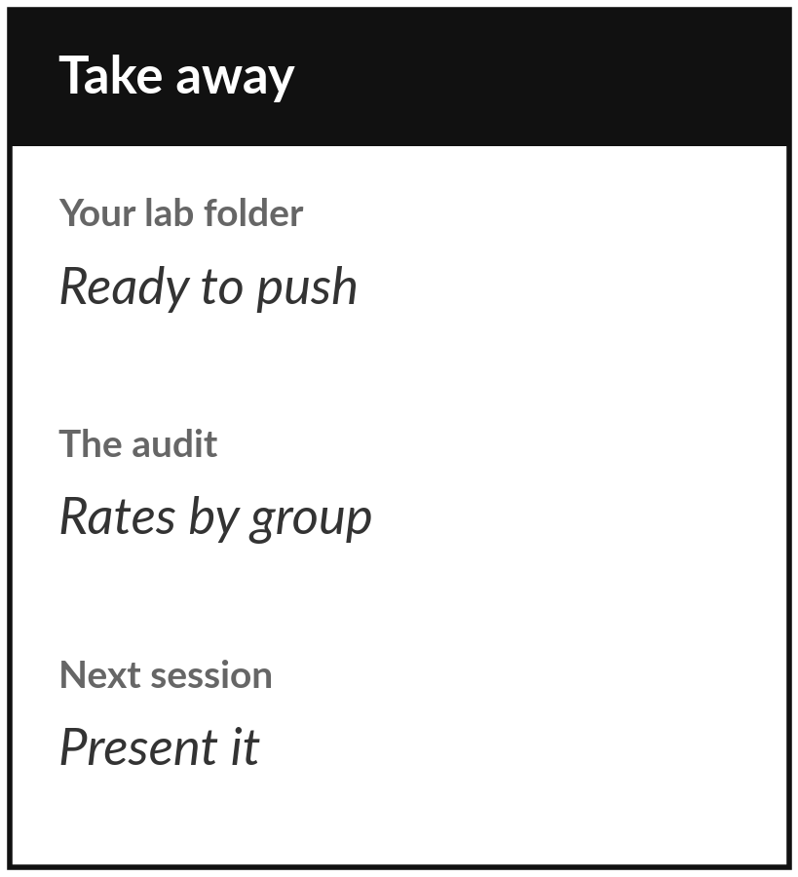
Save your shipping folder and
push it to your own GitHub
What you keep from today
Keep your shipping folder: the notebook, requirements.txt, loan_model.joblib, app.py and a completed model card with a fairness audit and a data protection checklist.
Our question today
How do we turn a notebook into something a colleague can repeat, use and trust?
Next session
Session 24: Present your course project and plan your path from here. You tell a result as an answer, evidence and limits, and plan what to learn next.
Notes:
Before you go, save the folder you built today. It holds the notebook, the requirements file, the saved model, the app file and a model card with the fairness audit. If you can hand it to a colleague and they can repeat your result without asking you anything, it is good.
Create a free GitHub account if you do not have one, and push the folder to a public repository after checking that no personal data is inside. Next session you present your course project, so bring your question and your result.
We began with this question: How do we turn a notebook into something a colleague can repeat, use and trust? Before you go, say in one sentence what you can now say about it.

